Slide 1
Digital Asset Planning
Mid-Iowa Estate & Financial Planners
September 19, 2017

Slide 2
Mission of
GORDON FISCHER LAW FIRM
To promote and maximize charitable giving in Iowa

Slide 3
4 Core Services
Wills, trusts, estates and estate planning
Formation of and guidance for nonprofits
Employment law counseling for nonprofits (including advice about hiring, firing, and drafting of policies and procedures)
Work with nonprofits and donors on major and/or complex gifts
Notes:
The mission of my law firm translates into five core services.
First, wills trusts, estates and estate planning. These are the topics that will spend our time together discussion.
Second, I conduct training for nonprofit boards. For example, later this week I’m going to speak to a nonprofit – a community foundation -- about donors and noncash assets.
Third, employment law guidance. Two quick examples. I’ll counsel nonprofits, and yes, small businesses, too, about firing employees. Make sure documentation is in order, and so on. Also, I’ll often draft employee handbooks for nonprofits.
Fourth service. I’ll handle compliance issues for nonprofits. I’ll start nonprofits – help the nonprofit complete a 1023 form and other paperwork to become a 501c3.
Fifth service. I’ll work with nonprofits and donors on complex gifts. If a donor wants to give a nonprofit a noncash asset, like real estate or a collection of antiques, I’ll help the parties with the legal paperwork. I may also draft gift agreements between the parties.
Again, these are my five core services.

Slide 5
One word: Complicated.

Slide 6
Add it up:
daily digital

Slide 7
A Short List
Computer
Tablet
Phone
Website (incl. blog)
GoFisch e-newsletter
Social media platforms
Credit Union accounts
Client/potential client information/templates/docs
Numerous programs/apps/sites
(business apps, news, sports, legal resources, NPs)

Slide 8
Fiduciaries need access

Slide 9
Revised Uniform Fiduciary Access to Digital Assets Act
(Iowa Code Chapter 638)

Slide 10
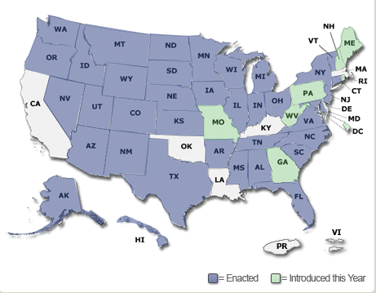

Slide 11
What constitutes a digital asset exactly?

Slide 12
Definition of “Digital Asset”
RUFADAA defines a “digital asset” as an “electronic record in which an individual has a right or interest.”
However, digital assets do NOT include an underlying asset or liability unless the asset or liability is itself an electronic record. Also, does NOT include
health records.

Slide 13
Digital Assets Act:
Three tiers

Slide 14
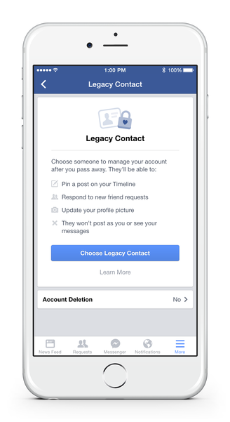
Tier One
If an online account service provider offers a mechanism for the account holder to outline their wishes post-mortem, then that tool is used as the primary instruction.

Slide 15
Tier One
Main takeaway:
If a digital service offers your clients the option to set what happens upon their passing—who should be notified/has access to the account—encourage them to use it.

Slide 16
Tier Two
If nothing is specified with the digital service provider, then directions in an estate plan are the clearest intention for the digital assets.

Slide 17
Tier Two
Main takeaway:
Include a written statement in the estate plan to specifically cover digital assets.
Don’t rely on general definitions of the executor’s powers, or what “assets” mean, to wrongly assume these cover digital assets.

Slide 18
Tier Three
If digital assets aren’t accounted for by a service provider tool or in an estate plan, then the determination of how the assets may be dealt with falls to the service agreement.
Such agreements typically prohibit anyone accessing the account aside from the owner.

Slide 19
Tier Three
Main takeaway:
MAKE DIGITAL ASSETS A PART OF ALL YOUR CLIENTS’ ESTATE PLANS.

Slide 20
Practical Items to Consider
Password manager like LastPass
Write down an inventory of accounts & keep it updated
Consider executor (or other fiduciary) access
Digital asset executor qualities: trustworthiness, respect for privacy, tech aptitude

Slide 21
GORDON FISCHER LAW FIRM, P.C.
325 E. Washington Street, Suite 100
Iowa City, IA 52240
GORDONFISCHERLAWFIRM.COM
515.371.6077 | gordon@gordonfischerlawfirm.com

