Slide 1
BASICS OF ESTATE PLANNING
Gordon Fischer Law Firm, P.C. April 26, 2017
Notes:
Good day, everyone. I’m Gordon Fischer, and this a seminar on Estate Planning and Charitable Giving. Just a little more information about me.

Slide 2
Gordon Fischer Law Firm, P.C.
325 E. Washington Street, Suite 100
Iowa City, IA 52240
WWW.GORDONFISCHERLAWFIRM.COM
515.371.6077 | gordon@gordonfischerlawfirm.com
Notes:
This is my contact information. My office address, cell phone number, email address. Feel free to reach out anytime for any reason.

Slide 3
Please ask questions!
Notes:
I’m so, so, so appreciative you are here!
Please ask questions.
Is there any way a live program makes sense? Only if you ask questions and get a dialogue going.
Candy!

Slide 4
Mission of
GORDON FISCHER LAW FIRM
To Promote And Maximize Charitable Giving In Iowa
Notes:
The mission of my law firm is to promote and maximize charitable giving in Iowa.
Two ways nonprofits can expand charitbale giving. BTw, I’m uisng the term “nonprofits,” very very broadly – your church, your high school, your university, advocacy groups, animal welfare groups; Iowa Iowa Senior Center!!!
Two ways nonprots can expand chartiable giving.
First, bequests.
Scond, noncash assets.

Slide 5
4 Core Services
Wills, trusts, estates and estate planning
Formation of, and guidance for, nonprofits
Employment law guidance for nonprofits including advice about hiring and firing, and drafting of policies and procedures
Working with nonprofits and donors on major and/or complex gifts
Notes:
The mission of my law firm translates into five core services.
First, wills trusts, estates and estate planning. These are the topics that will spend our time together discussion.
Second, I conduct training for nonprofit boards. For example, later this week I’m going to speak to a nonprofit – a community foundation -- about donors and noncash assets.
Third, employment law guidance. Two quick examples. I’ll counsel nonprofits, and yes, small businesses, too, about firing employees. Make sure documentation is in order, and so on. Also, I’ll often draft employee handbooks for nonprofits.
Fourth service. I’ll handle compliance issues for nonprofits. I’ll start nonprofits – help the nonprofit complete a 1023 form and other paperwork to become a 501c3.
Fifth service. I’ll work with nonprofits and donors on complex gifts. If a donor wants to give a nonprofit a noncash asset, like real estate or a collection of antiques, I’ll help the parties with the legal paperwork. I may also draft gift agreements between the parties.
Again, these are my five core services.

Slide 6
Three Learning Objectives
Five major reasons you need an estate plan
Six “must have” estate planning documents
Eight common mistakes in estate planning (and how to avoid them!)
Notes:
I’m going to start out with the basics. Let’s begin with three learning objectives about wills, trusts, estates, and estate planning.
[Read objectives]
I know we have a broad range of knowledge about these topics. Some folks are brand new to this subject. Other folks may be very, very familiar – in fact, they know as much or more than me! But let’s start with these basics, to make sure we all have the same foundational understanding.

Slide 7
Questions are encouraged!
Notes:
I’m so, so, so appreciative you are here!
Please ask questions.
Is there any way a live program makes sense? Only if you ask questions and get a dialogue going.
Candy!

Slide 8
One word: Simple.

Slide 9
What do you mean by an estate plan, anyway?
An estate plan consists of several legal documents to prepare for death or disability.
Yes, you need an estate plan.

Slide 10
Six Major Reasons You Need An Estate Plan
Reason #1
Without an estate plan, the Iowa Legislature
and/or Iowa courts will decide just about
EVERYTHING about your estate.

Slide 11
Six Major Reasons You Need An Estate Plan
Reason #2
Without an estate plan, you cannot choose a legal guardian for your children.

Slide 12
Notes:
Kids! Especially minors. Most especially, blended families!
Does anyone know, or have a guess, as to why blended families have unique challenges to blended families. The laws are old! Doesn’t meet with Modern Family!

Slide 13
Notes:
Young marrieds. Socking aside retirement funds. Trying to save for a house.
Sara? Her inherited IRA. Well, she’s very pregnant.
Lacy? She has a kid. And her own business!
Caitlyn? Her family’s lakehouse.
Also, the rich need estate planning, but the non rich need estate planning even more! Joe Robbe – team was sold, name stripped form stadium.

Slide 14
Six Major Reasons You Need An Estate Plan
Reason #3
Without an estate plan, your estate’s executor will be chosen by probate court.

Slide 15
Six Major Reasons You Need An Estate Plan
Reason #4
Without an estate plan, you are not in control over how your assets will be distributed.

Slide 16
Six Major Reasons You Need An Estate Plan
Reason #5
Without an estate plan, your estate may pay more in professional fees, court costs,
and taxes.

Slide 17
Six Major Reasons You Need An Estate Plan
Reason #6
Without an estate plan, at death, you cannot support the causes you care most passionately about.

Slide 19
What are six major reasons you need an estate plan?

Slide 20
Six Must Have Estate Planning Documents
Estate planning questionnaire
Last Will and Testament
Health care power of attorney
Financial power of attorney
Instructions for the disposition of personal property
Final Disposition (i.e. burial instructions)

Slide 21
What Do You Mean By An Estate Planning Questionnaire?
EPQ organizes all the important info & people pertinent to your estate plan in one place.
Completing this form will provide the info needed to tailor your estate plan to your exact needs.

Slide 22
Where can I find an
Estate Planning Questionnaire?
www.gordonfischerlawfirm.com
Downloadable, fillable PDF.
A questionnaire can help get you there.

Slide 23
Six Must Have Estate Planning Documents
Estate planning questionnaire
Last Will and Testament
Health care power of attorney
Financial power of attorney
Instructions for the disposition of personal property
Final Disposition (i.e. burial instructions)

Slide 24
What Is A Will, Anyway?
A will is a written document that:
Directs the distribution of your property at death
States who will distribute that property

Slide 25
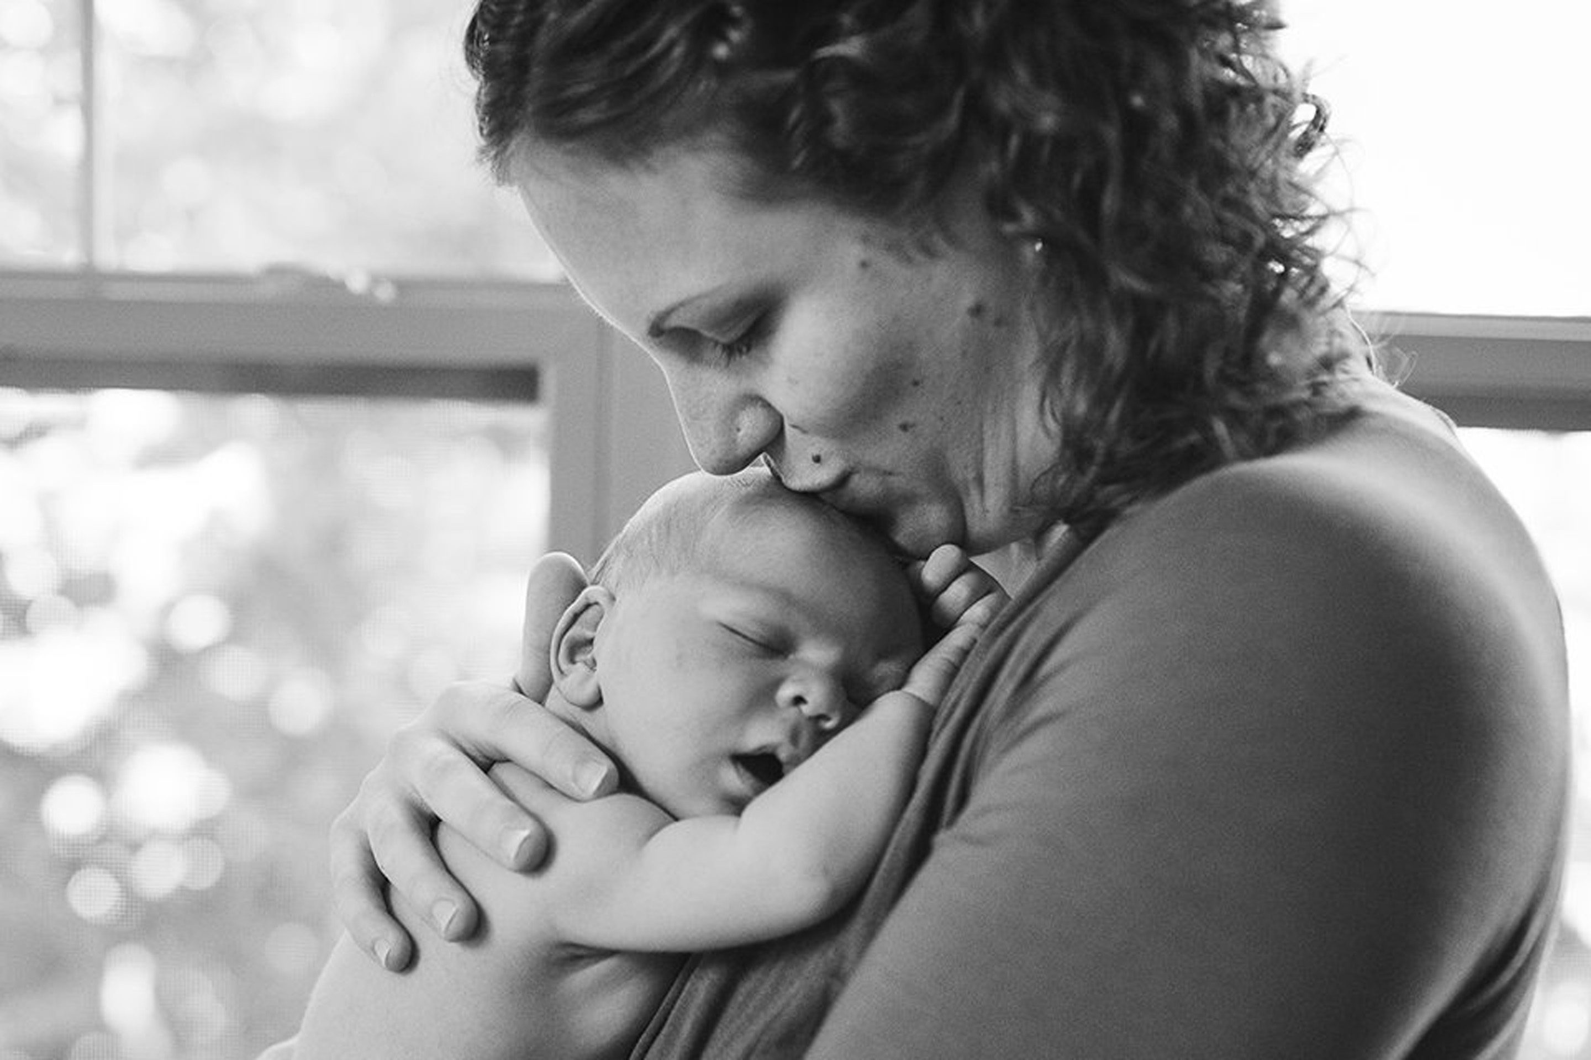

Slide 26
How Is a Will Different Than an Estate Plan?
A will is one document, albeit a critical one, in your entire estate plan.
An estate plan is a set of documents that includes your will and any additional documents created to prepare for your death or disability.

Slide 27
What is Required for a Will to be Legally Valid in Iowa?
Maker (testator) must be at least 18 years of age or married
Maker must tell the witnesses it is their will
Maker must be of “sound mind”
Will must be written and signed by maker in presence of at least two competent witnesses, at least 16 years of age, who also sign will in presence of maker and each other

Slide 28
What Does “Sound Mind” Mean?
Understands the nature of the instrument s/he is executing
Knows and understands the nature and extent of her/his property
Remembers the natural objects of her/his bounty
Knows the distribution s/he wants to make

Slide 29
Any questions?
Notes:
I’m so, so, so appreciative you are here!
Please ask questions.
Is there any way a live program makes sense? Only if you ask questions and get a dialogue going.
Candy!

Slide 30
Six Must Have Estate Planning Documents
Estate planning questionnaire
Last Will and Testament
Health care power of attorney
Financial power of attorney
Instructions for the disposition of personal property
Final Disposition (i.e. burial instructions)

Slide 31
What Is A Health Care
Power Of Attorney?
A health care power of attorney is a written legal document which designates someone, or more than one person, to make medical decisions for you if you cannot.

Slide 32
What Types of Health Care Decisions are Governed by a
Power Of Attorney?
Any kind of decision that is related to your health that you allow.
You could limit your representative to certain types of decisions or you could allow your representative to make any health care decision that might arise.

Slide 33
Does Health Care Power Of Attorney Arise just for End-Of-Life Decisions?
Contrary to popular belief, this power and authorization is more than just dealing with the “end-of-life” decision. It can be ANY health care decision.

Slide 34
Is a Health Care Power of Attorney the Same as a Living Will?
A living will is essentially your own instructions, while a health care power of attorney designates an agent to make decisions about you and your health care.

Slide 35
Six Must Have Estate Planning Documents
Estate planning questionnaire
Last Will and Testament
Health care power of attorney
Financial power of attorney
Instructions for the disposition of personal property
Final Disposition (i.e. burial instructions)

Slide 36
What Is a Financial Power Of Attorney?
A financial power of attorney is a written instrument that designates someone to handle your financial decisions on your behalf.

Slide 37
What if I Don’t Have a Financial Power Of Attorney?
If you do not have a power of attorney and were to become incapacitated, any financial decisions would need to be made by a court-appointed conservator.
At a court’s direction, the conservator would handle your financial assets. It’s a very expensive and time consuming process, especially compared to the simplicity of a power of attorney.

Slide 38
After I Die, Can My Agent Still Use Financial Power Of Attorney?
A common misperception is that your agent will be able to use this power after your death.
At your death, any power of the attorney-in-fact is automatically revoked and it will be necessary to switch management to the representative appointed through probate.

Slide 39
Can My Agent Mishandle or Misuse Financial or Health Care Power Of Attorney?
It’s possible, so you should choose an agent with utmost care and make it someone in whom you have complete confidence.
A well-written power of attorney can be very clear about what powers an agent has (and doesn’t have), and handle all potential contingencies.

Slide 40
Notes:
OK, so you’re kids are grown up. Why do you need an estate plan?

Slide 41
Six Must Have Estate Planning Documents
Estate planning questionnaire
Last Will and Testament
Health care power of attorney
Financial power of attorney
Instructions for the disposition of personal property
Final Disposition (i.e. burial instructions)

Slide 42
What are Instructions for Distribution Of Personal Property?
On this form, you can designate specific items of your tangible personal property to go to certain people after your death.
Ex: I give my baseball cards to my nephew and antique bookcase to my sister.

Slide 43
Advantages of Using Instructions for Distribution Of Personal Property?
It’s very easy to use this form.
You can change this form or add items to the form as often as you wish without a formal amendment (known as a “codicil”) to your Will.

Slide 44
Six Must Have Estate Planning Documents
Estate planning questionnaire
Last Will and Testament
Health care power of attorney
Financial power of attorney
Instructions for the disposition of personal property
Final Disposition (i.e. burial instructions)

Slide 45
What are Final Disposition Instructions?
Final Disposition Instructions give you the opportunity to:
specify how how to deal with your remains
provide details of any prior arrangements
designate the person(s) to carry out your wishes

Slide 46
I Understand the Six Must Have Estate Planning Documents.
What else?
Don’t forget about your beneficiary designations.
savings and checking accounts
retirement benefit plans mutual funds
insurance policies

Slide 47
I Understand The Six “Must Have” Estate Planning Documents.
What else?
You need to keep them UPDATED and CURRENT.

Slide 48
When do I Revisit or Update my Estate Plan?
When you undergo major life changes, such as:
Move to a new state
Acquire significant new property
Financial situation changes
At the birth, adoption, or death of a child, grandchild, or other heir

Slide 49
When do I Revisit or Update my Estate Plan?
Ideally, on an annual basis.

Slide 50
Six Must Have Estate Planning Documents
Estate planning questionnaire
Last Will and Testament
Health care power of attorney
Financial power of attorney
Instructions for the disposition of personal property
Final Disposition (i.e. burial instructions)

Slide 51
BONUS TIME

Slide 53
PROBATE

Slide 54
Give me all of your questions.
Notes:
I’m so, so, so appreciative you are here!
Please ask questions.
Is there any way a live program makes sense? Only if you ask questions and get a dialogue going.
Candy!

Slide 55
Downsides of Probate
Roughly 2% charge on ALL assets
Takes about an entire year
Non-private

Slide 56
Trust Benefits
Save 2%
Quicker
Private
Favorable tax options
More creditor protection

Slide 57
Trusts
Revocable vs. Irrevocable
Inter vivos vs. Testamentary

Slide 59
Gordon Fischer Law Firm, P.C.
325 E. Washington Street, Suite 100
Iowa City, IA 52240
WWW.GORDONFISCHERLAWFIRM.COM
515.371.6077 | gordon@gordonfischerlawfirm.com
Notes:
This is my contact information. My office address, cell phone number, email address. Feel free to reach out anytime for any reason.

